Slide 1
AI Enablement &
Future State Architecture
Readiness Assessment — Implementation Ready in 8 Weeks
Ball Corp AI Investments: Databricks · Microsoft Purview · Azure AI Foundry
This is a readiness assessment and architecture design exercise — not an AI delivery project
Audience: Technical leads & architects · Scoring: 1–5 maturity model · 4 dimensions assessed

Slide 2
Workstream Context & Scope
Workstream Purpose
Ball Corp's AI and analytics investments — Databricks, Microsoft Purview and Azure AI Foundry — are committed. These platforms require a CDM-governed, medallion-structured data foundation to operate accurately and safely. This workstream assesses readiness and defines the path from current state to an AI-capable ecosystem. It is a readiness assessment and architecture design exercise, not an AI delivery project.
4 Deliverables from this workstream:
D1 Platform Integration Blueprint
D2 Enterprise Knowledge Graph
D3 AI Control Tower Requirements
D4 Data Quality Certification
How CDM, Databricks, Purview &
AI Foundry work together
Ontology · Instance ·
Lineage · Vector tiers
Policy · audit ·
model governance
DQ framework for
AI readiness per tier
Scope boundary: This workstream does NOT deliver working AI agents, production connectors, or a deployed data pipeline — it delivers the architecture, assessment, and certified-data design that enables those projects to begin safely.

Slide 3
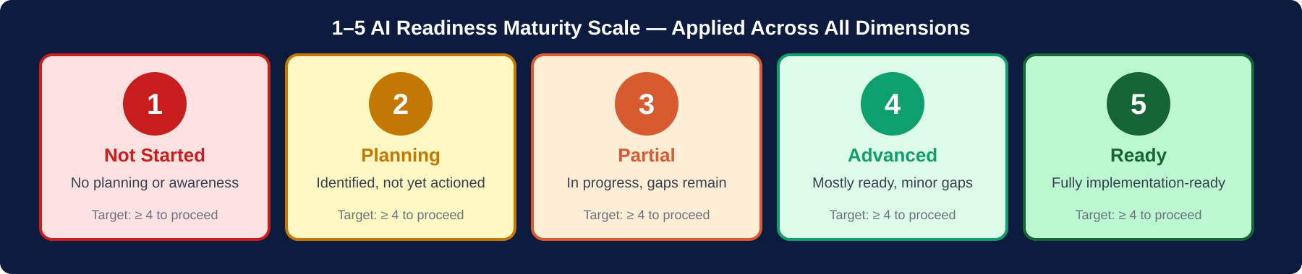
Assessment Methodology · 1–5 Maturity Scale
Target: all dimensions ≥ 4/5 by Week 8. Scores < 3 are hard blockers before any AI platform connects to CDM data.

Slide 4
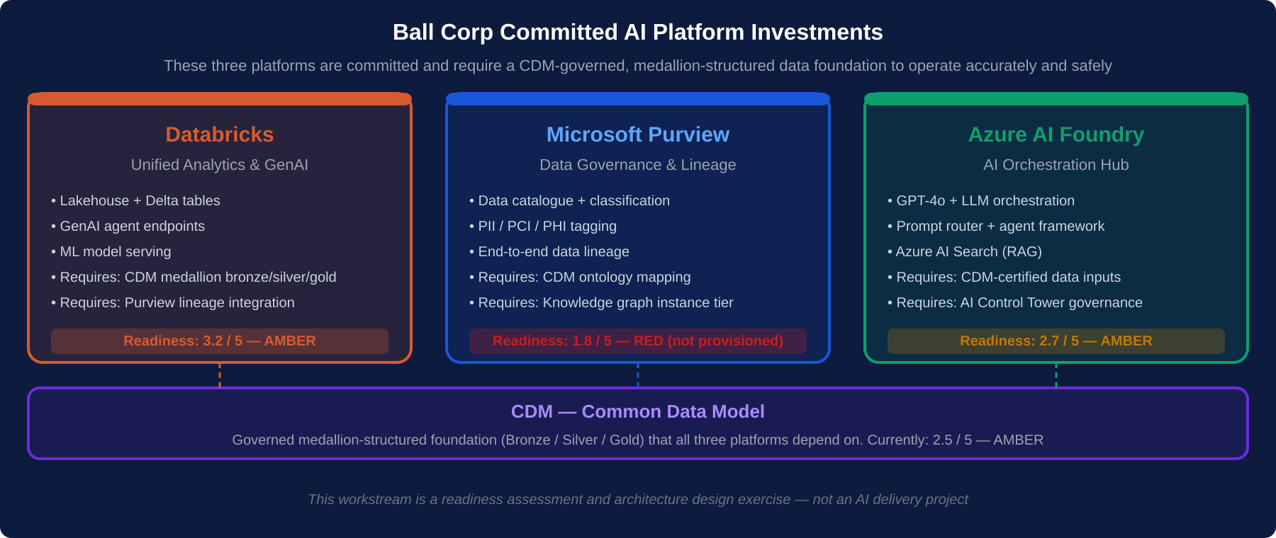
Ball Corp Committed AI Platforms · Current Readiness vs CDM Dependency
All three platforms depend on CDM-governed medallion data. CDM foundation must reach Gold tier before AI platforms can operate accurately.

Slide 5
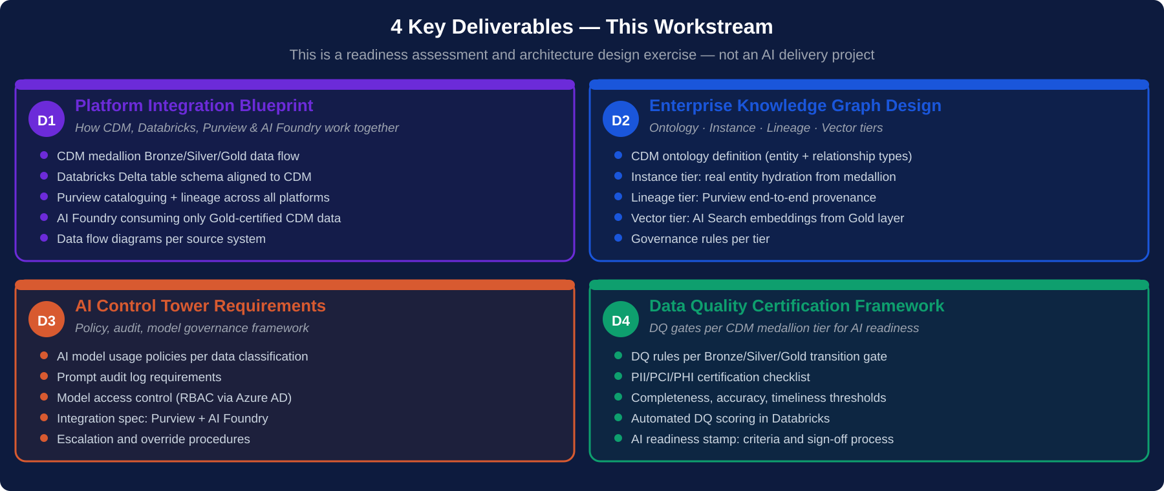
4 Key Deliverables — Architecture Design Outputs
These are architecture and design deliverables — specifications, frameworks and blueprints that enable subsequent AI delivery projects.

Slide 6
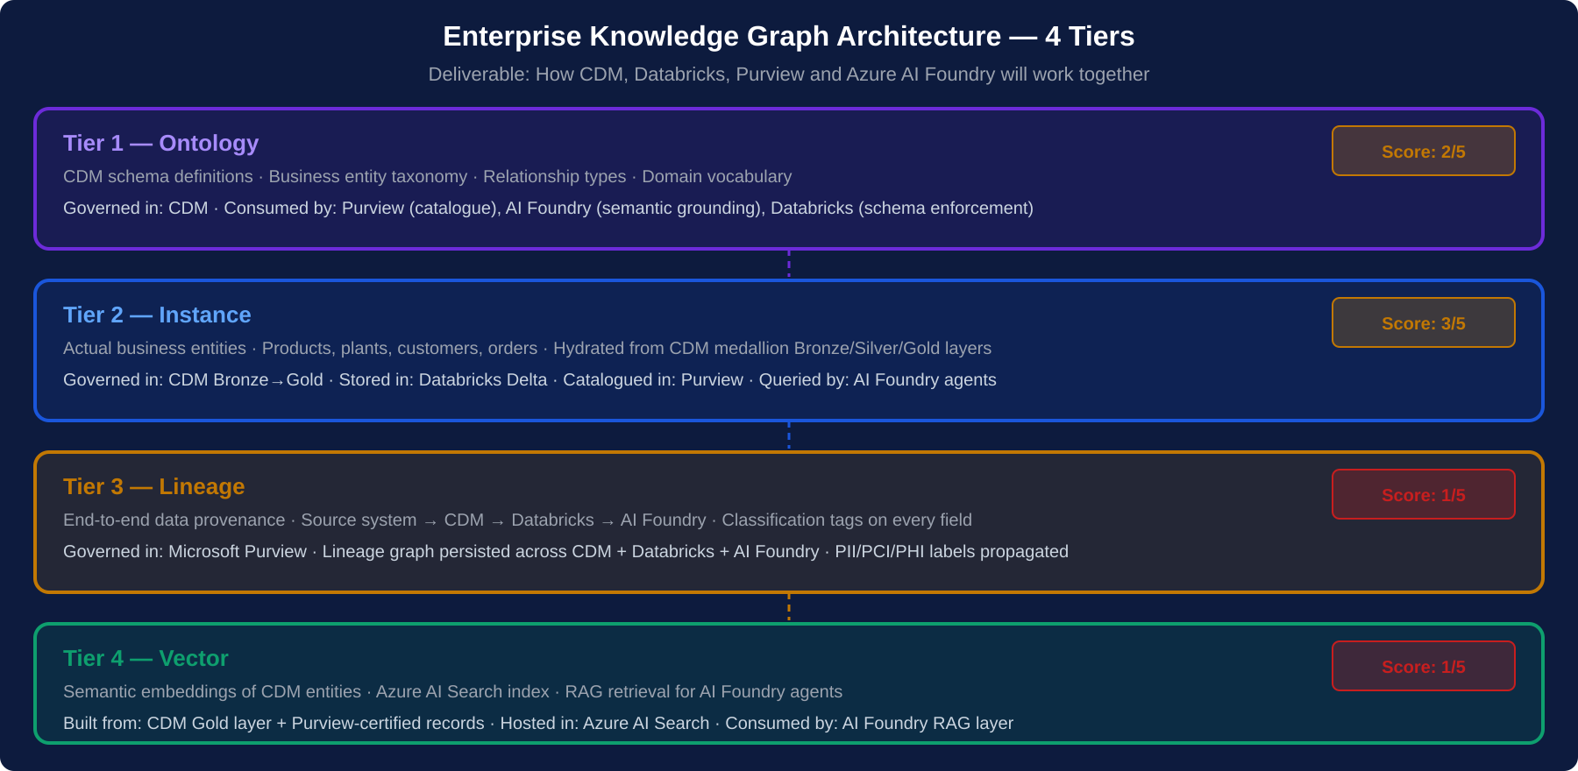
Enterprise Knowledge Graph — 4-Tier Architecture Design
Ontology and Lineage tiers score 1/5 — no existing structure. Vector tier (AI Search) does not exist. All 4 tiers are deliverable D2.

Slide 7
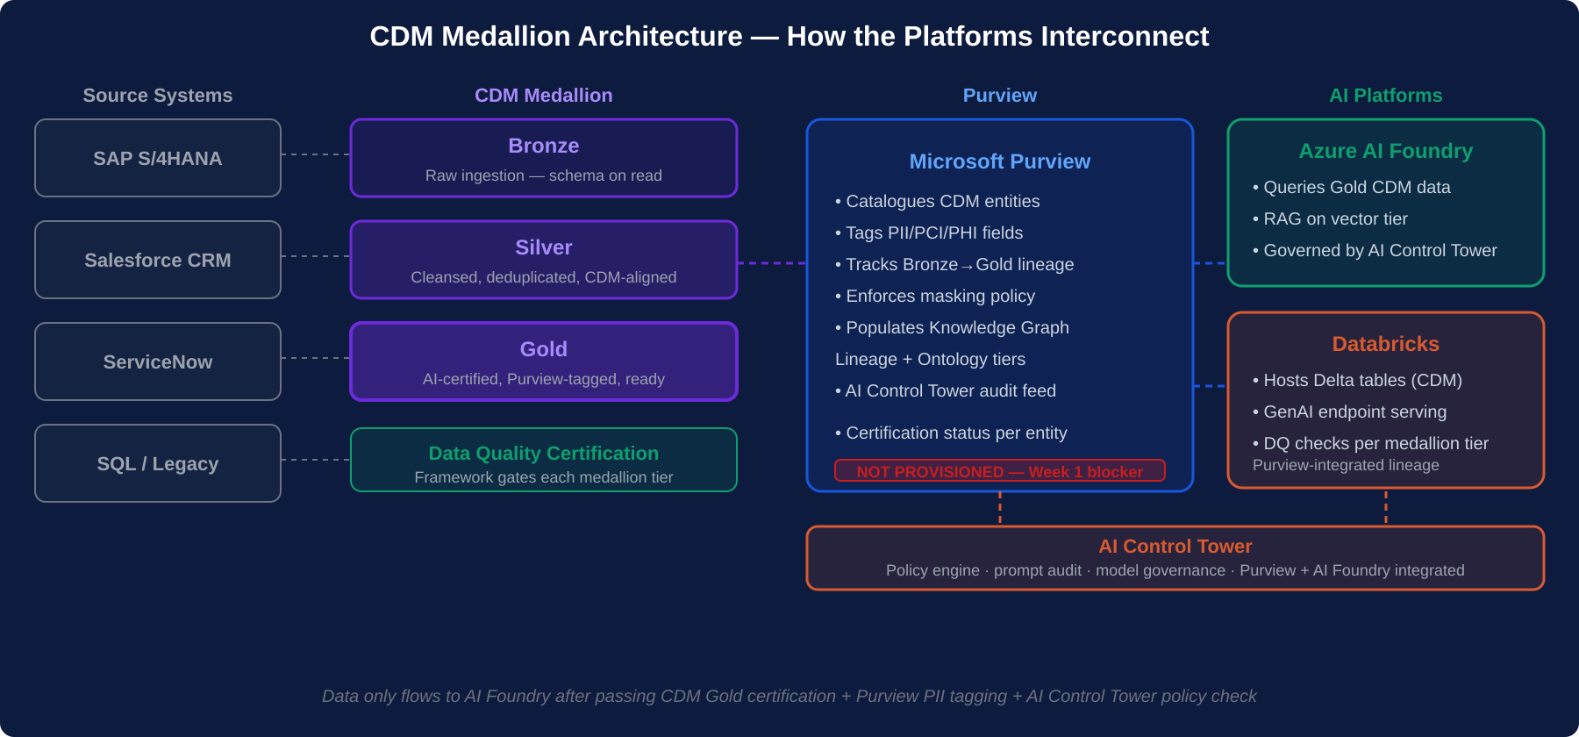
CDM Medallion Architecture — Platform Integration Blueprint (D1)
Data only flows to AI Foundry after passing CDM Gold certification + Purview PII tagging + AI Control Tower policy check.

Slide 8
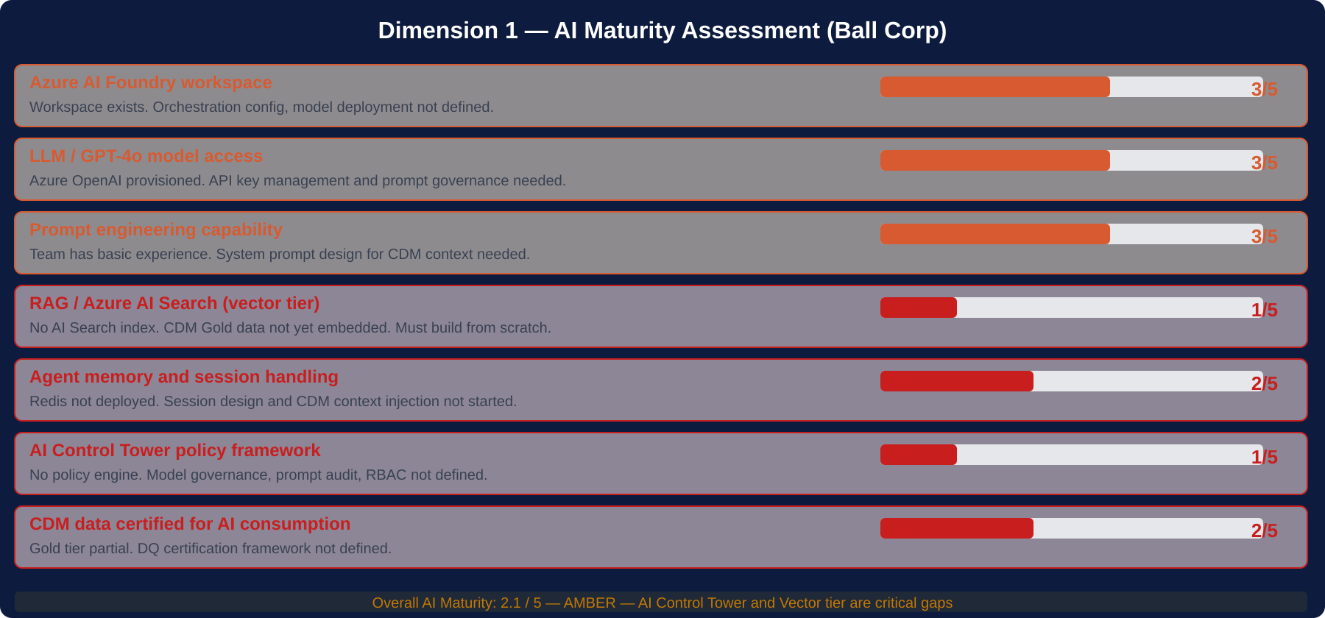
Dimension 1 of 4 · AI Maturity Assessment
AI Control Tower (1/5) and Vector tier (1/5) are the critical design gaps. Foundry workspace exists but is not configured for CDM-governed data.

Slide 9
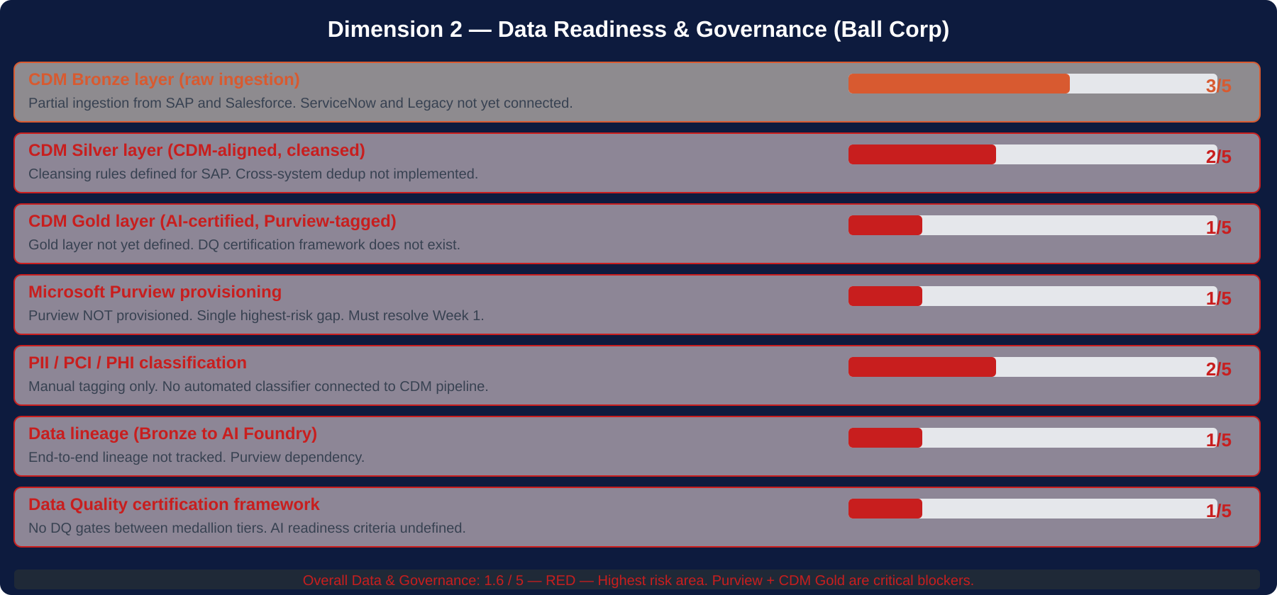
Dimension 2 of 4 · Data Readiness & Governance
Purview (1/5) and CDM Gold (1/5) are hard blockers. No data should enter AI Foundry until both are resolved and DQ certification framework is live.

Slide 10
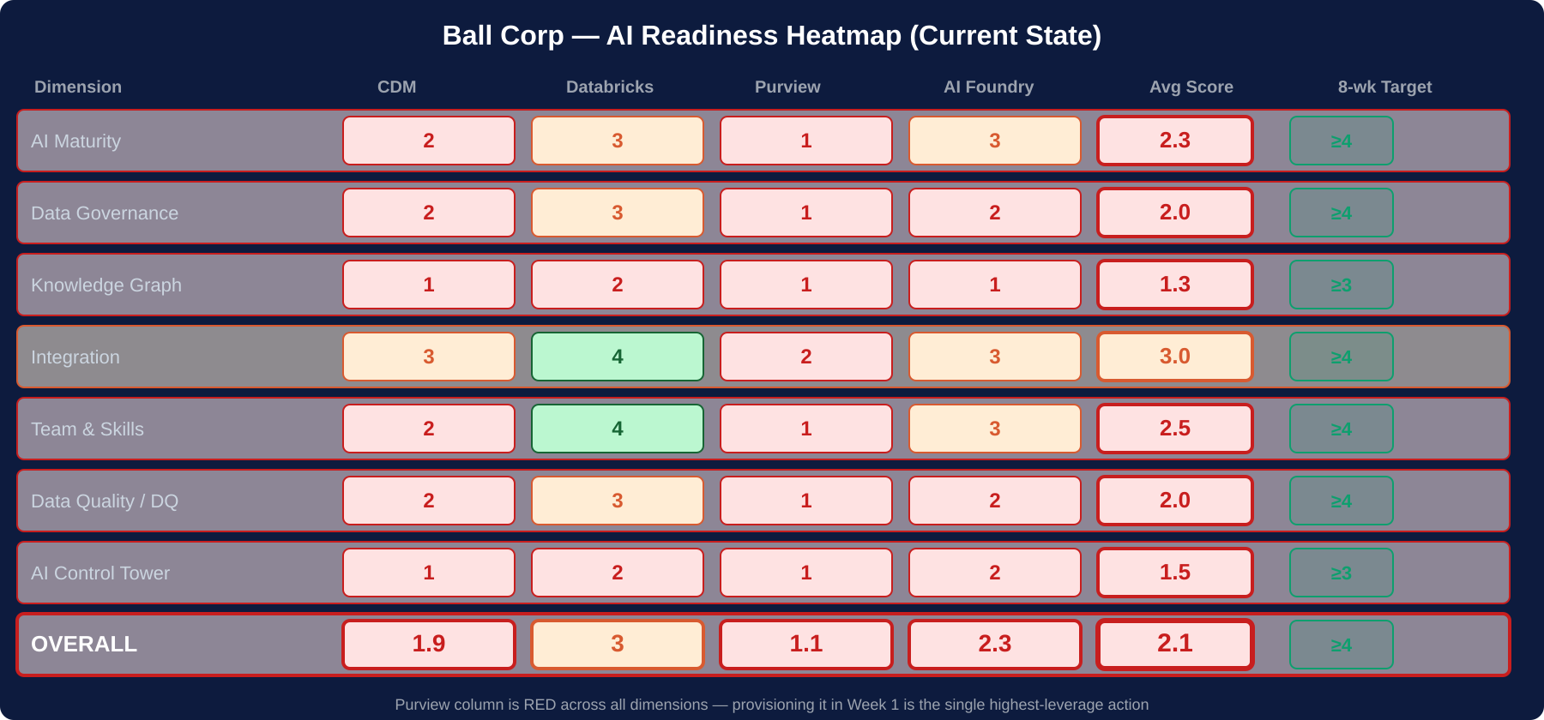
Overall Readiness Heatmap · All Dimensions × All Platforms
Purview scores RED across every single dimension — provisioning it in Week 1 is the single highest-leverage action in the entire 8-week program.

Slide 11
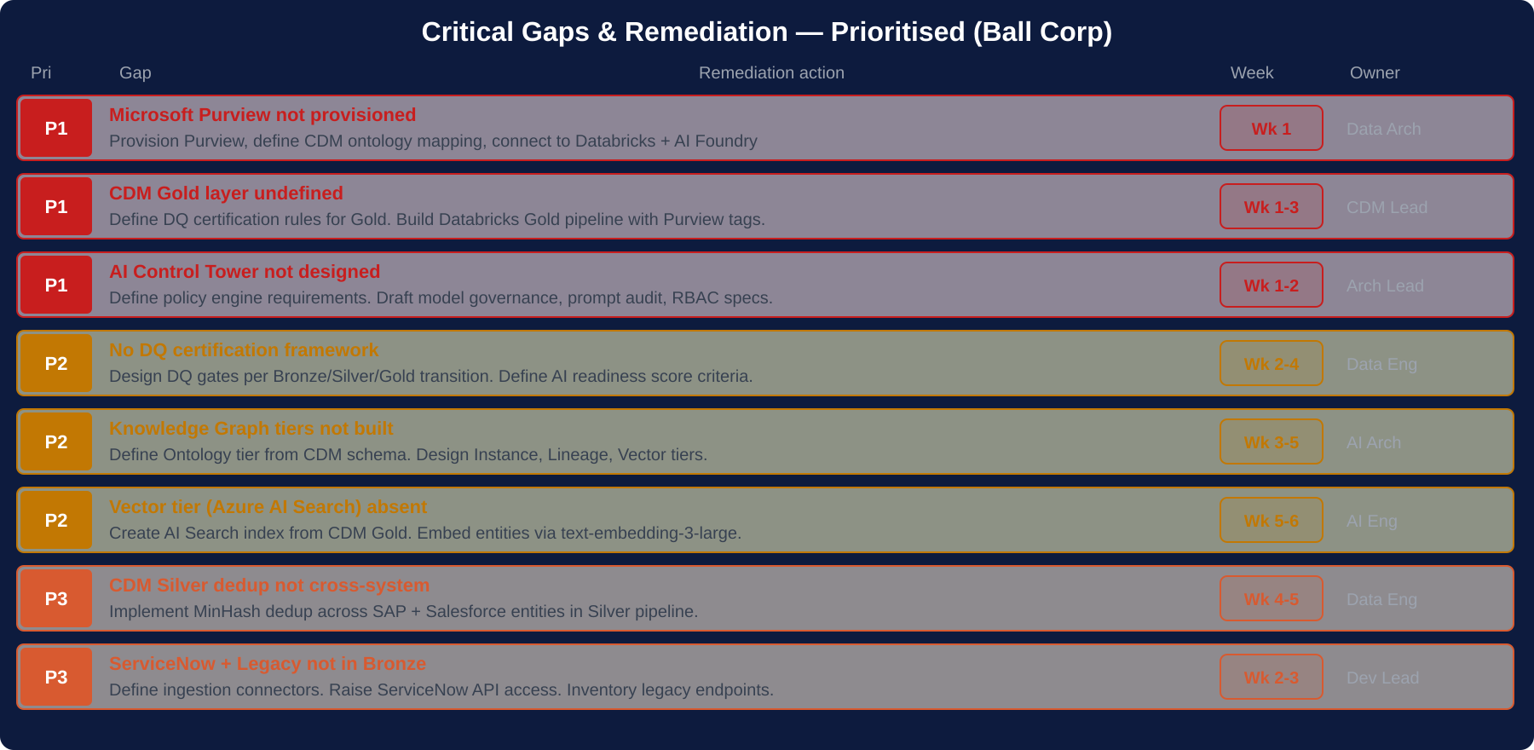
Critical Gaps & Remediation — Prioritised (Ball Corp)
P1 gaps must be resolved before Week 3. No AI platform should receive CDM data until Purview, Gold tier and AI Control Tower specs are complete.

Slide 12
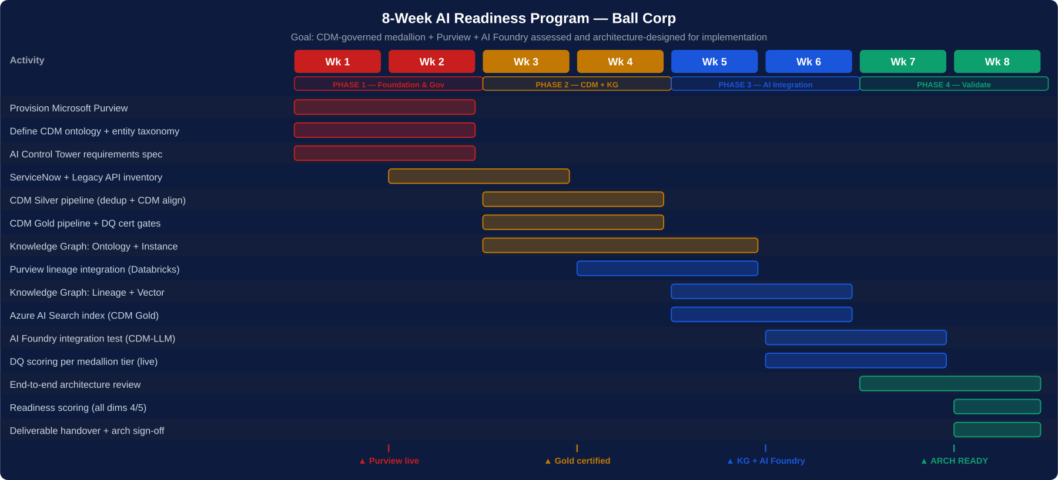
8-Week Architecture-Ready Program — Ball Corp Sprint Timeline
End state: CDM Gold certified + Purview live + Knowledge Graph designed + AI Foundry integration tested = architecture-ready for AI delivery projects.

Slide 13
Week-by-Week Sprint Detail — Ball Corp 8-Week Program
Wks 1–2
Wks 3–4
Wks 5–6
Wks 7–8
Phase 1 — Foundation & Governance
Phase 2 — CDM Medallion + DQ
Phase 3 — Knowledge Graph + AI
Phase 4 — Validate & Certify
Provision Microsoft Purview (Day 1 hard start)
CDM Silver pipeline (dedup + CDM alignment)
Knowledge Graph: Lineage tier (Purview-driven)
End-to-end architecture review (all 4 dims)
Define CDM ontology + entity taxonomy
CDM Gold pipeline + DQ certification gate rules
Knowledge Graph: Vector tier (AI Search index)
AI readiness scoring — all dims ≥ 4/5
Design AI Control Tower requirements spec
Purview tagging integration with Databricks
Azure AI Search: embed CDM Gold entities
Platform Integration Blueprint (D1) finalised
ServiceNow API access request + Legacy inventory
Knowledge Graph: Ontology + Instance tier design
AI Foundry integration test (CDM → LLM query)
Knowledge Graph design (D2) finalised
Define PII/PCI/PHI classification rules for CDM
Connect remaining sources to Bronze layer
DQ certification scoring live in Databricks
AI Control Tower requirements (D3) finalised
Engage external Purview/CDM specialist
DQ scoring framework per medallion tier
Validate AI Control Tower policy spec
DQ Certification Framework (D4) finalised

Slide 14
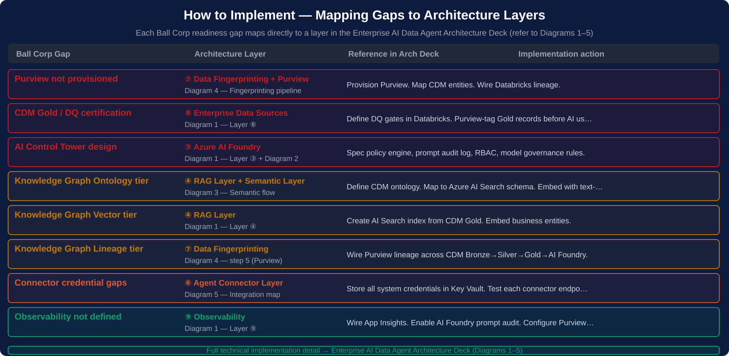
How to Implement — Ball Corp Gaps Mapped to Architecture Layers
Use the Enterprise AI Data Agent Architecture Deck alongside this assessment. Each gap row references the exact diagram and layer to follow.

Slide 15
Definition of Architecture-Ready — 8 Exit Criteria
All criteria must score ≥ 4/5 before any AI delivery project begins
✓
Microsoft Purview live
✓
CDM Gold tier certified
Purview provisioned, CDM entities catalogued, PII/PCI/PHI tags applied, lineage tracking active
DQ gates defined and passing per medallion tier. Gold data certified for AI consumption.
✓
AI Control Tower spec complete
✓
Knowledge Graph all 4 tiers designed
Policy engine requirements documented. Prompt audit, RBAC, model governance specs signed off.
Ontology, Instance, Lineage, Vector tiers fully specified and validated against CDM schema.
✓
Platform integration blueprint (D1)
✓
DQ certification framework (D4)
Data flow from CDM Bronze to Silver to Gold to Purview to AI Foundry documented and agreed.
DQ rules per tier, AI readiness score criteria, automated scoring in Databricks live.
✓
Vector tier (AI Search) indexed
✓
Security and governance sign-off
CDM Gold entities embedded in Azure AI Search. Hybrid search returning relevant results.
Data governance review complete. No P1 lineage, PII, or access control gaps open.

Slide 16
AI Enterprise Orchestration Architecture RoadMap
Visual reference for all key architecture components
5 diagrams follow — suitable for technical and executive audiences

Slide 17
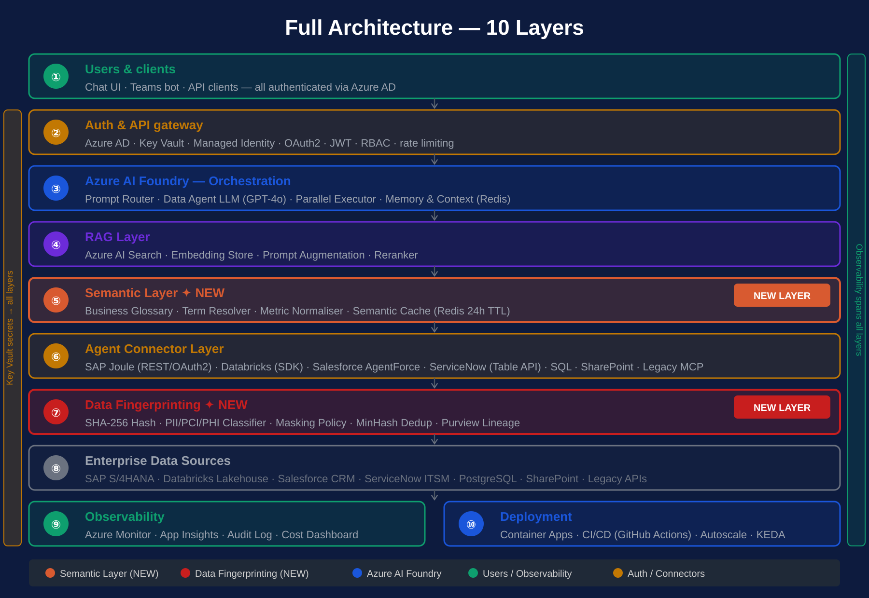
Diagram 1 of 5 · Full Architecture — 10 Layers
Layers ⑤ Semantic and ⑦ Data Fingerprinting are new additions highlighted in orange and red.

Slide 18
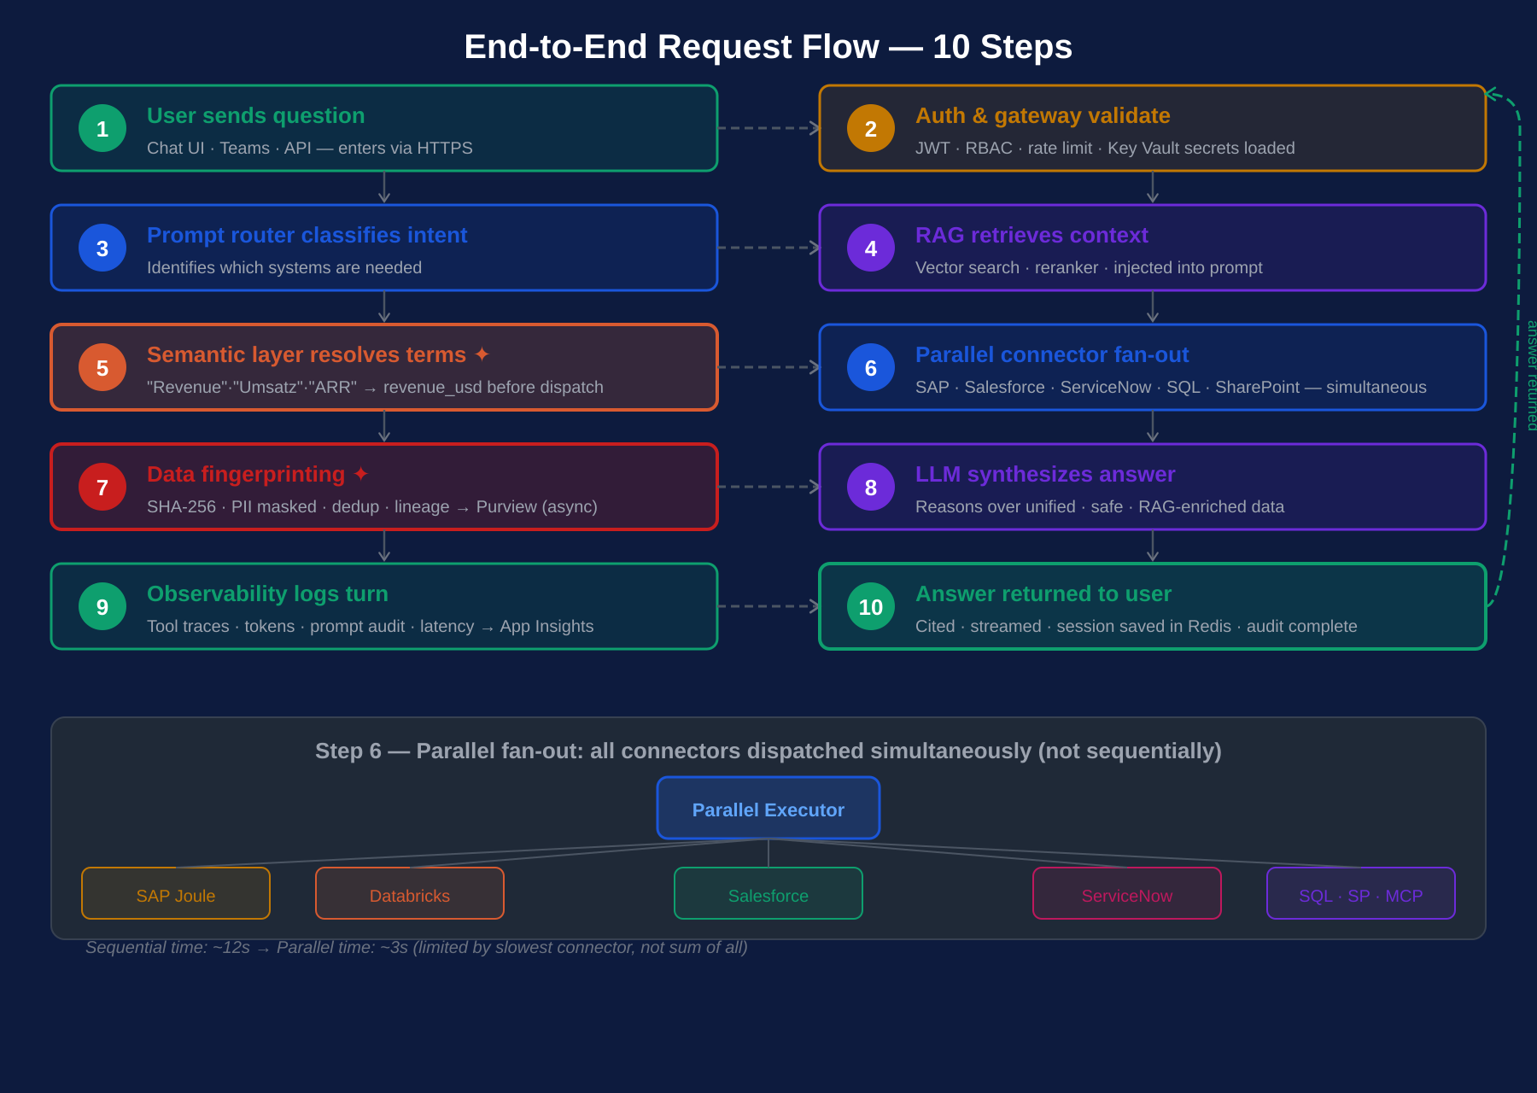
Diagram 2 of 5 · End-to-End Request Flow — 10 Steps
Parallel fan-out (step 6) reduces response time from ~12s sequential to ~3s.

Slide 19
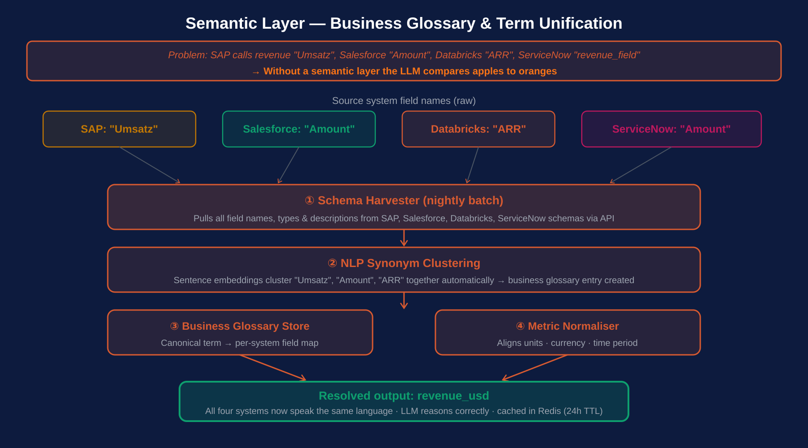
Diagram 3 of 5 · Semantic Layer — Business Glossary & Term Unification
Runs nightly (schema harvest) and per-query (term resolution, cached in Redis 24h TTL).

Slide 20
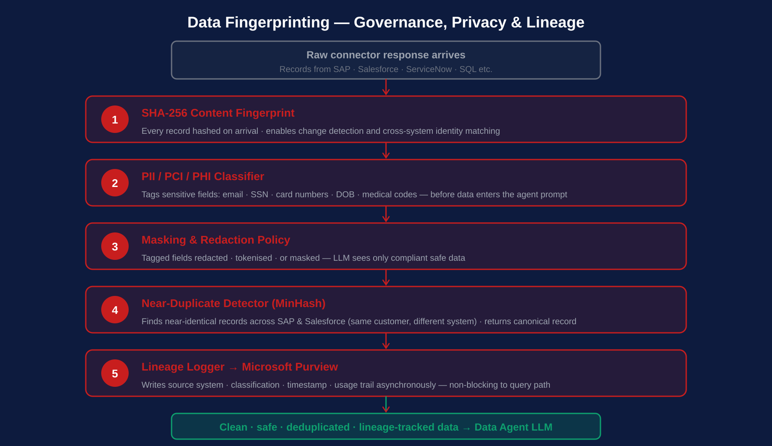
Diagram 4 of 5 · Data Fingerprinting — Governance, Privacy & Lineage
All 5 steps run inline per record fetch. Lineage write to Purview is async and non-blocking.

Slide 21
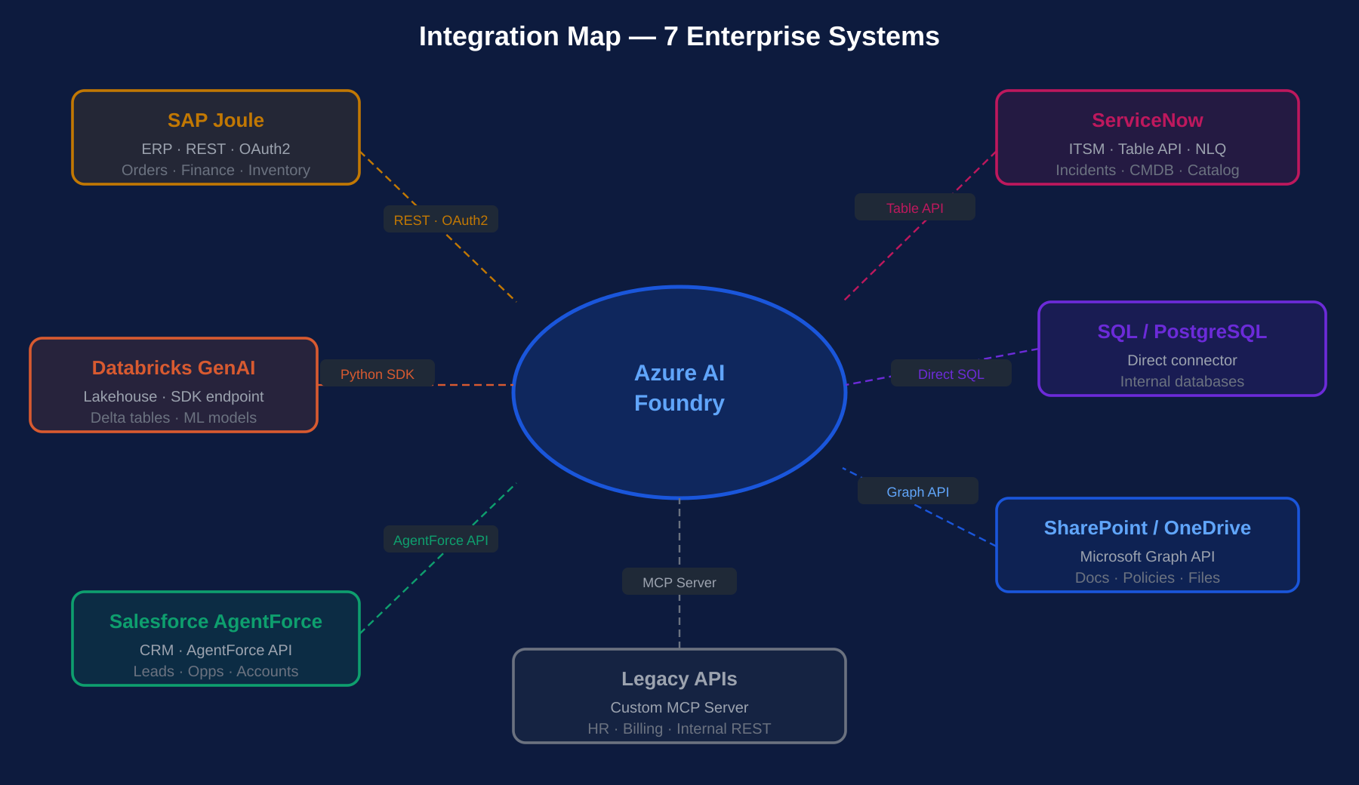
Diagram 5 of 5 · Integration Map — 7 Enterprise Systems
Each spoke shows the connection method: REST/OAuth2, SDK, AgentForce API, Table API, Graph API, Direct SQL, MCP Server.

Slide 22
Next Steps
Ball Corp — AI Enablement & Future State Architecture
1
Accept assessment findings
Review dimension scorecards with CDM, Databricks, Purview and AI Foundry leads. Agree on current scores and P1 gaps.
2
Provision Purview — Day 1
Purview scores 1/5 across ALL dimensions. Provisioning it is the single highest-leverage action. Raise this ticket before leaving the room.
3
Kick off Phase 1 sprint
Stand up Purview, define CDM ontology, begin AI Control Tower spec. Engage external CDM/Purview specialist immediately.
4
Define CDM Gold certification rules
No AI platform should receive data until Gold tier has defined DQ gates. Block AI Foundry access until Gold + Purview are live.
5
Use Architecture Deck for implementation
Every gap maps to a layer in the Enterprise AI Data Agent Architecture Deck. Use Diagrams 1–5 as the technical implementation guide.
6
Gate on 8 exit criteria at Week 8
Do not commence AI delivery projects until all 8 architecture-ready criteria score 4/5 or above and governance sign-off is obtained.
Thank you — questions welcome

